Slide 1
Git and GitHub

Slide 2
Git
Git is free and open source software for distributed version control: tracking changes in any set of files, usually used for coordinating work among programmers collaboratively developing source code during software development.
Git was originally authored by Linus Torvalds in 2005
Git Download link : https://git-scm.com/downloads

Slide 3
GitHub
GitHub, Inc. is an Internet hosting service for software development and version control using Git. It provides the distributed version control of Git plus access control, bug tracking, software feature requests, task management, continuous integration, and wikis for every project.

Slide 4
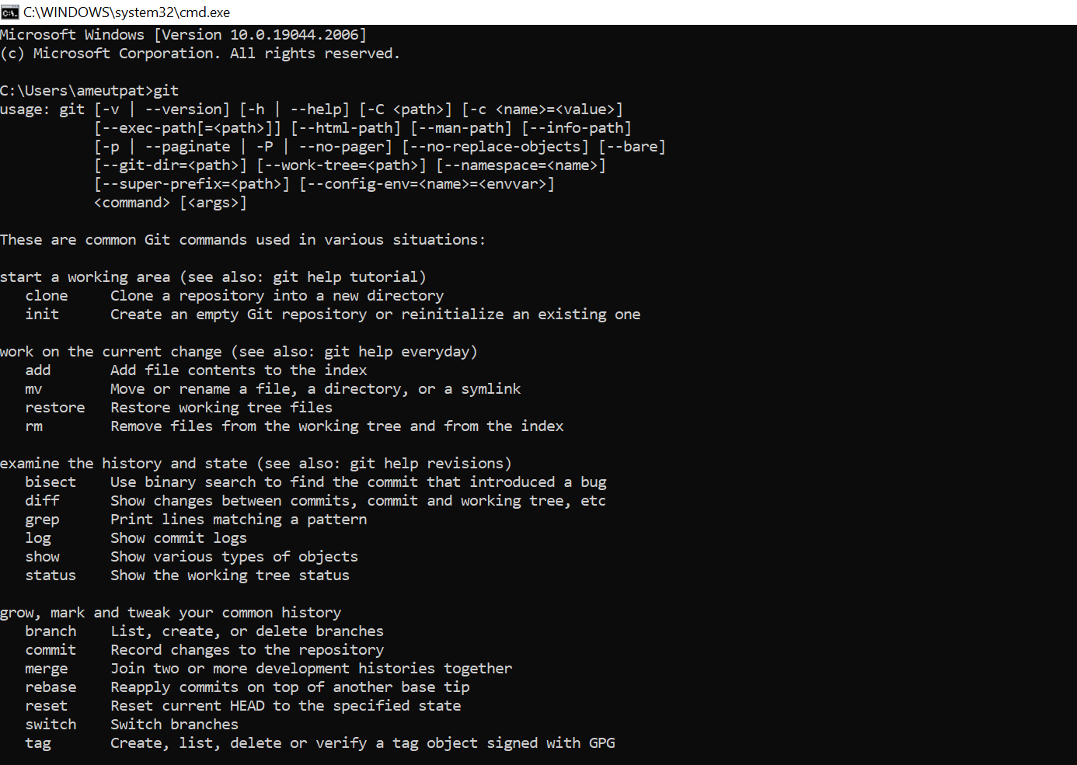
Type “git” on cmd after installation

Slide 5
git init
The git init command is the first command that you will run on Git. The git init command is used to create a new blank repository. It is used to make an existing project as a Git project. Several Git commands run inside the repository, but init command can be run outside of the repository.
The git init command creates a .git subdirectory in the current working directory. This newly created subdirectory contains all of the necessary metadata. These metadata can be categorized into objects, refs, and temp files. It also initializes a HEAD pointer for the master branch of the repository.

Slide 6
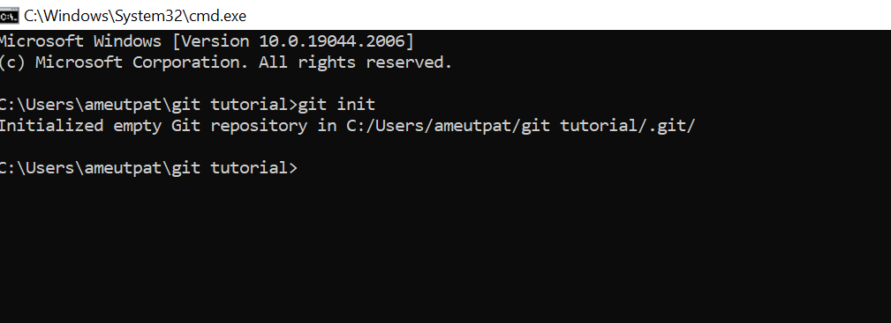
git init
The below command will initialize a .git repository on the desktop. Now we can create and add files on this repository for version control.

Slide 7
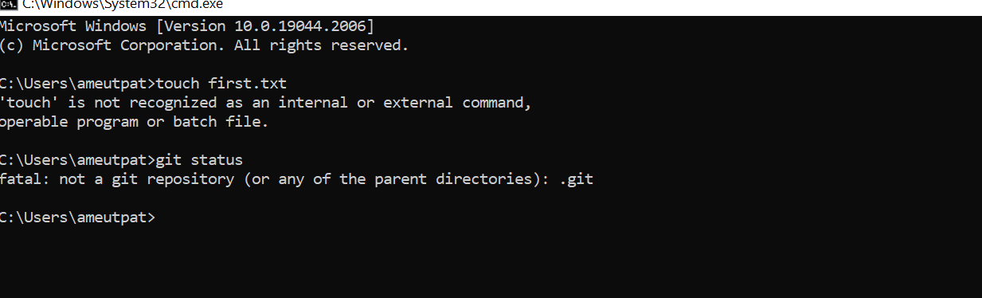
Tried to use some git commands in non git repository

Slide 8
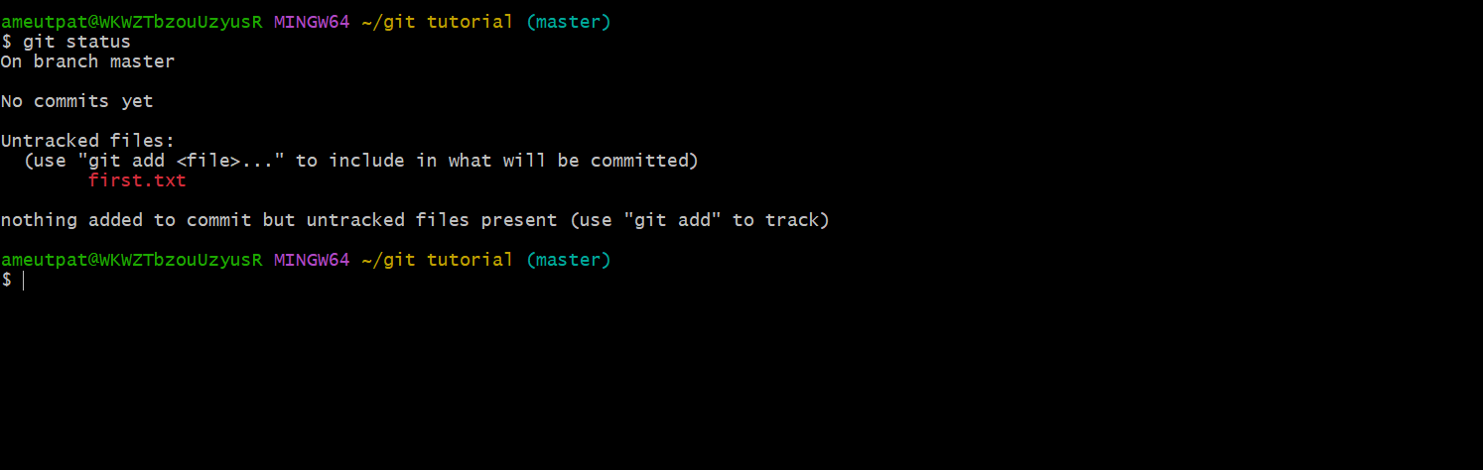
git status
We can list all the untracked files by git status command.

Slide 9
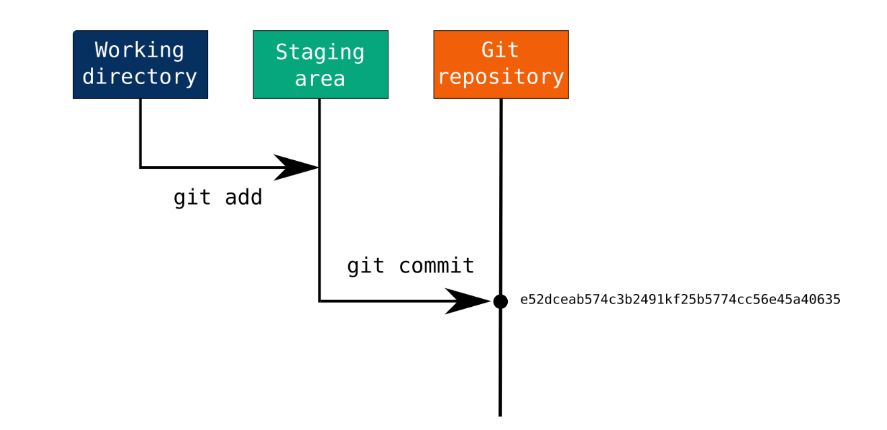

Slide 10
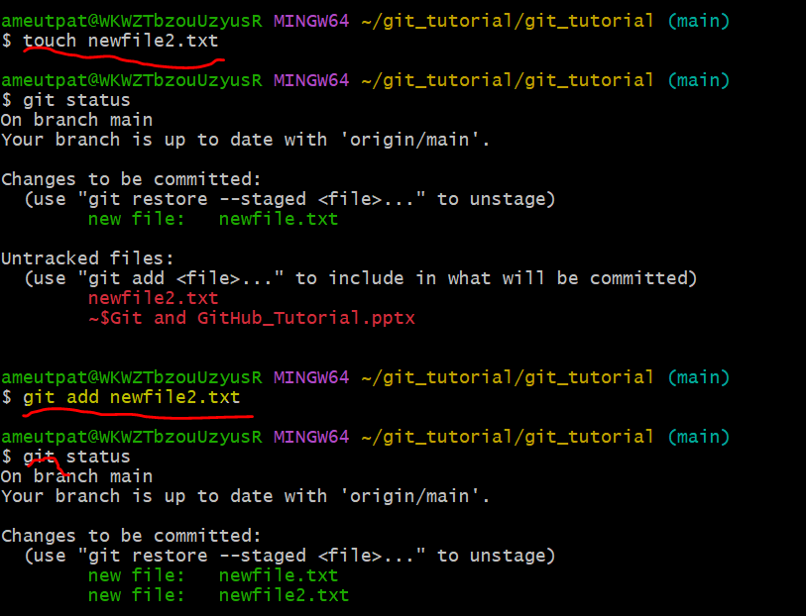
Git add .
Git add command is a straightforward command. It adds files to the staging area. We can add single or multiple files at once in the staging area.

Slide 11
Removing Files from the Staging Area
The git add command is also used to remove files from the staging area. If we delete a file from the repository, then it is available to our repository as an untracked file. The add command is used to remove it from the staging area. It sounds strange, but Git can do it. Consider the below scenario:
We have deleted the newfile.txt from the repository. The status of the repository after deleting the file is as follows:

Slide 12
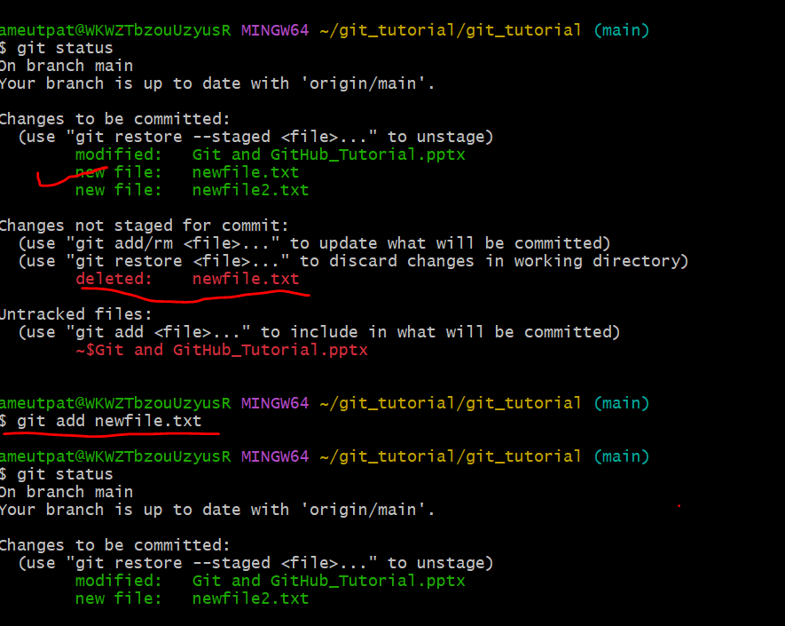

Slide 13
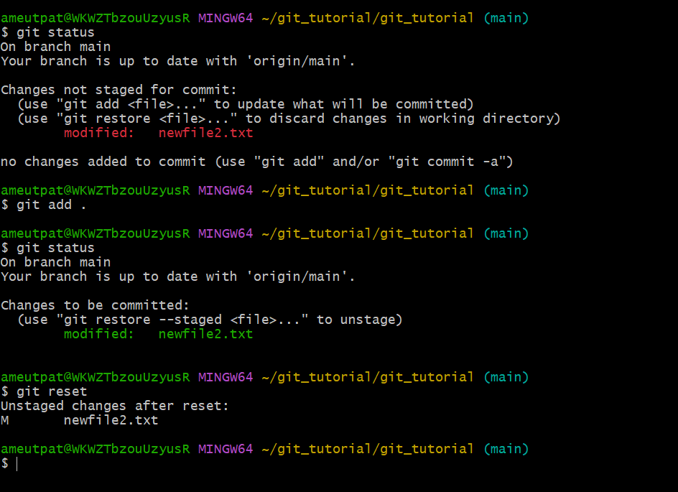
Git reset
We can undo a git add operation using git reset command.

Slide 14
Git Commit
It is used to record the changes in the repository. It is the next command after the git add.Every commit contains the index data and the commit message.
The staging and committing are co-related to each other. Staging allows us to continue in making changes to the repository, and when we want to share these changes to the version control system, committing allows us to record these changes.
Commits are the snapshots of the project. We can recall the commits or revert it to the older version. Two different commits will never overwrite because each commit has its own commit-id. This commit-id is a cryptographic number created by SHA (Secure Hash Algorithm) algorithm.

Slide 15
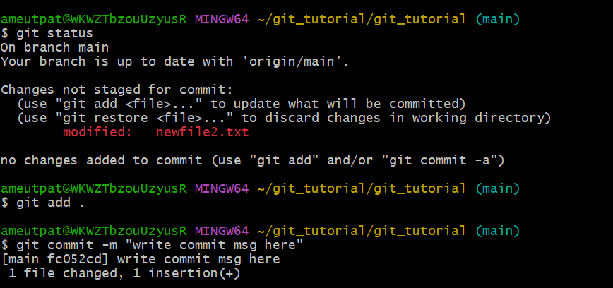
Git commit -m

Slide 16
git log
Git log command is one of the most usual commands of git. It is the most useful command for Git. Every time you need to check the history, you have to use the git log command. The basic git log command will display the most recent commits and the status of the head.

Slide 17
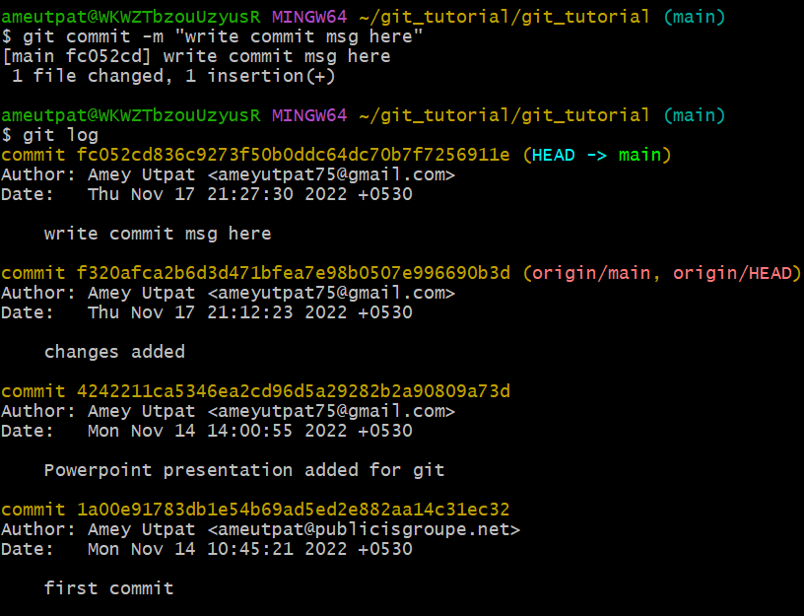
git log

Slide 18
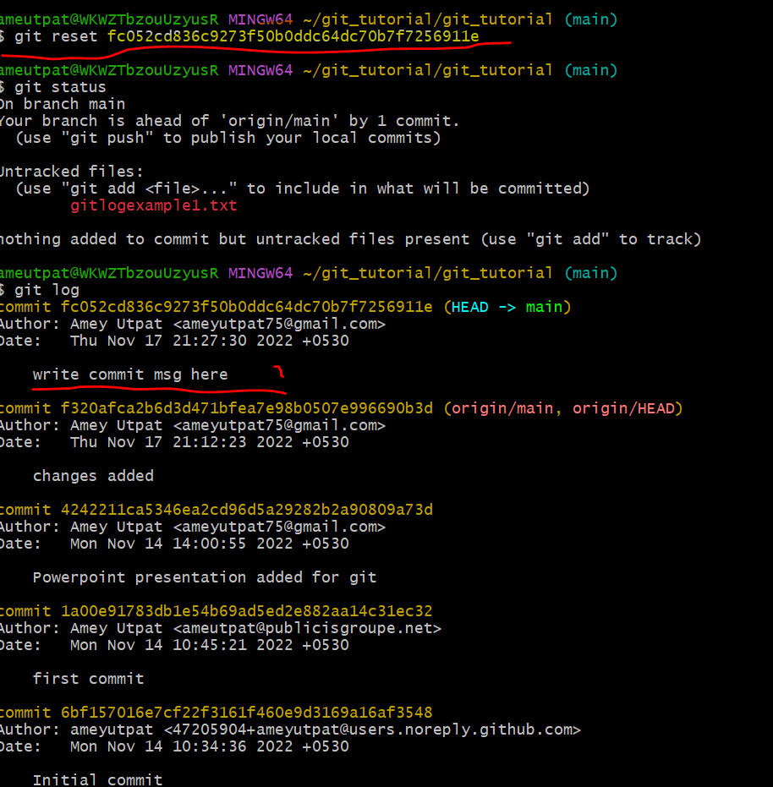
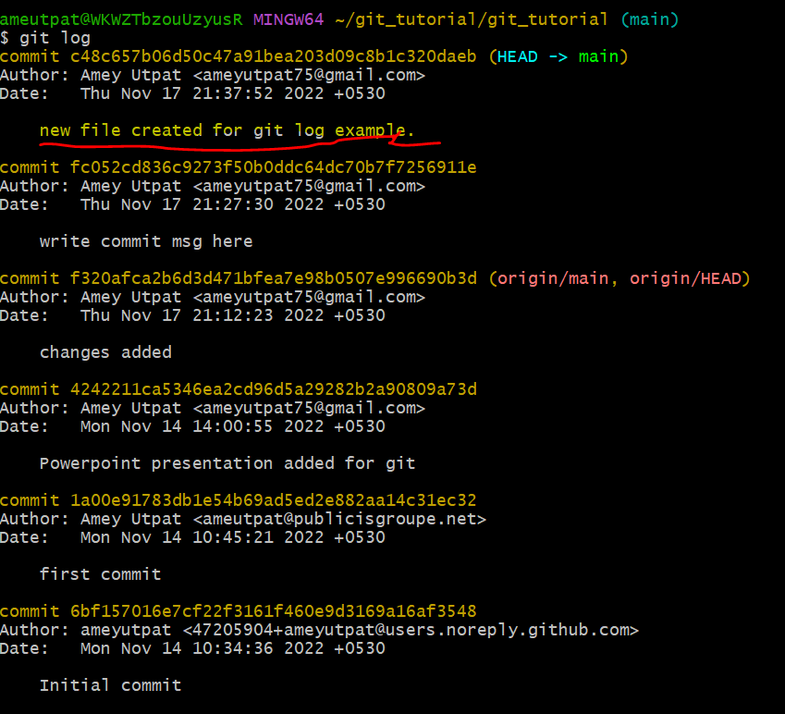
git reset commit id
It will reset to specific commit for which commit id is given
Before reset logs
After reset logs

Slide 19
git stash
Suppose you are implementing a new feature for your product. Your code is in progress and suddenly a customer escalation comes. Because of this, you have to keep aside your new feature work for a few hours. You cannot commit your partial code and also cannot throw away your changes. So you need some temporary space, where you can store your partial changes and later on commit it.
In Git, the stash operation takes your modified tracked files, stages changes, and saves them on a stack of unfinished changes that you can reapply at any time.
Now, you want to switch branches for customer escalation, but you don’t want to commit what you’ve been working on yet; so you’ll stash the changes. To push a new stash onto your stack, run the git stash command.

Slide 20
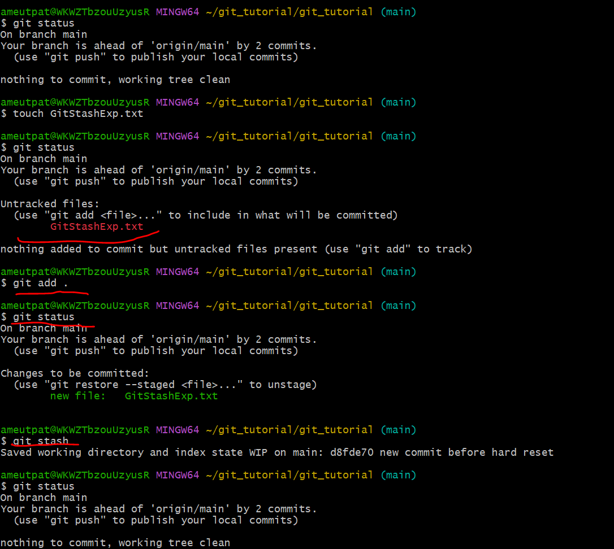
Git stash

Slide 21
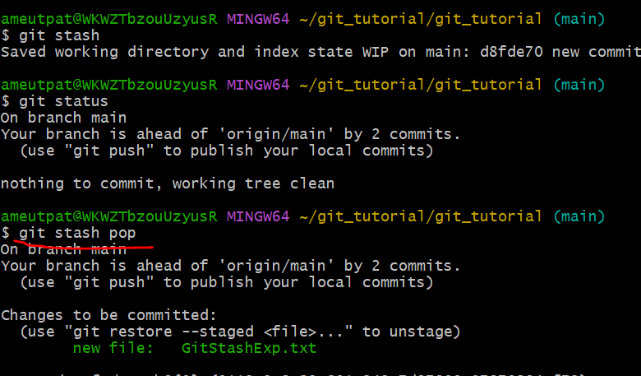
Git stash pop
Git allows the user to re-apply the previous commits by using git stash pop command. The popping option removes the changes from stash and applies them to your working file.
The git stash pop command is quite similar to git stash apply. The main difference between both of these commands is stash pop command that deletes the stash from the stack after it is applied.

Slide 22
git fork
A fork is a rough copy of a repository. Forking a repository allows you to freely test and debug with changes without affecting the original project. One of the excessive use of forking is to propose changes for bug fixing. To resolve an issue for a bug that you found, you can:
Fork the repository.
Make the fix.
Forward a pull request to the project owner.
Forking is not a Git function; it is a feature of Git service like GitHub.

Slide 23
git clone
In Git, cloning is the act of making a copy of any target repository. The target repository can be remote or local. You can clone your repository from the remote repository to create a local copy on your system. Also, you can sync between the two locations.
The git clone is a command-line utility which is used to make a local copy of a remote repository. It accesses the repository through a remote URL.
Usually, the original repository is located on a remote server, often from a Git service like GitHub, Bitbucket, or GitLab. The remote repository URL is referred to the origin.

Slide 24
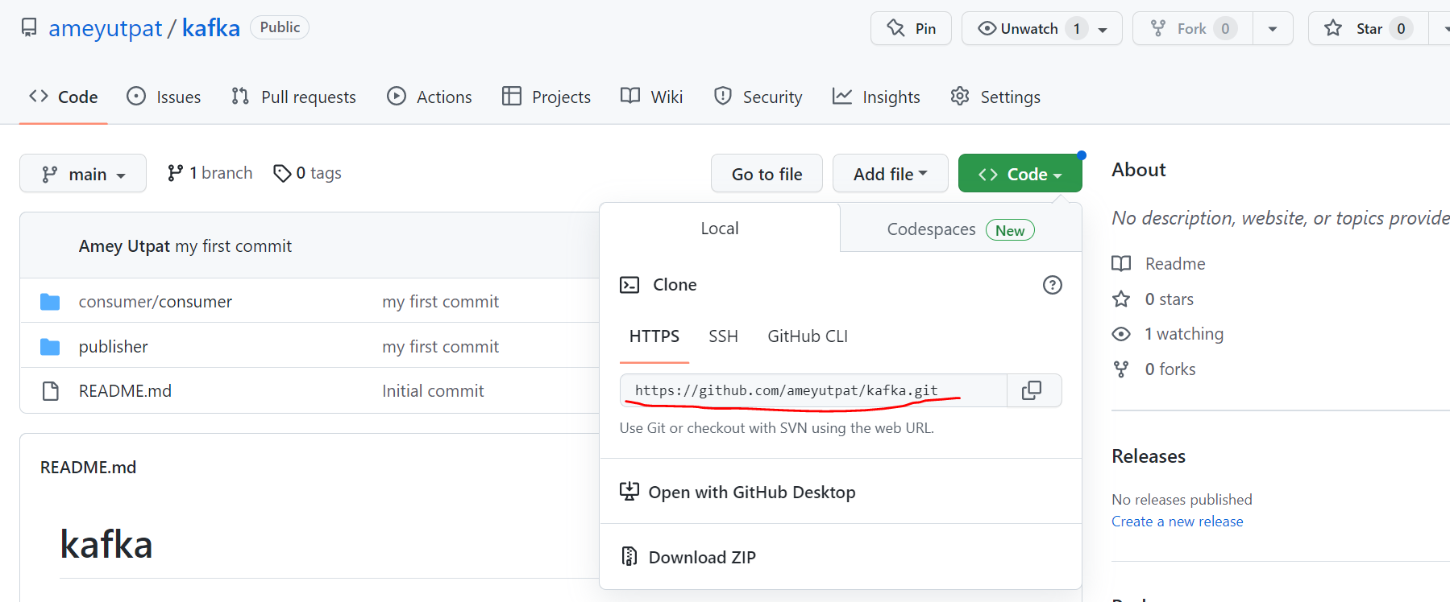
Git clone steps
1.copy the url from github

Slide 25
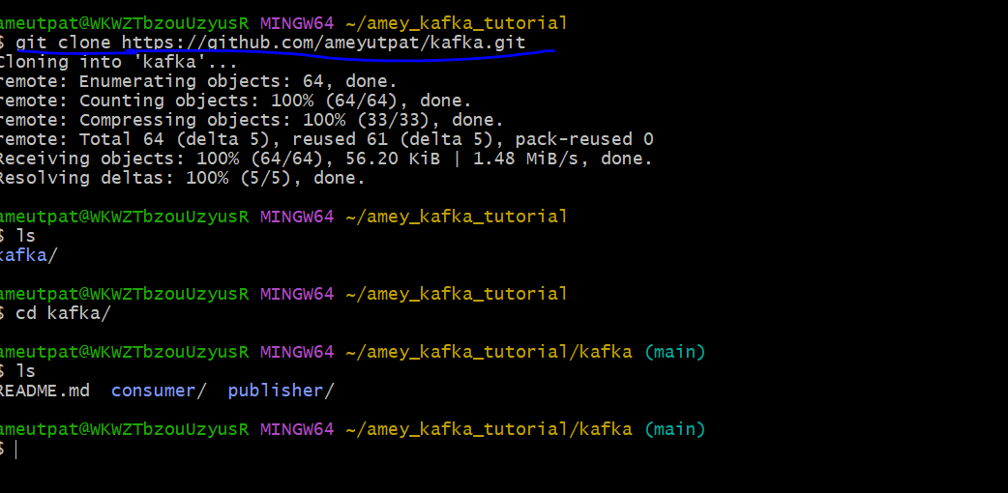
git clone github_url

Slide 26
git branch
A branch is a version of the repository that diverges from the main working project.
A Git project can have more than one branch.
When you want to add a new feature or fix a bug, you spawn a new branch to summarize your changes. So, it is complex to merge the unstable code with the main code base and also facilitates you to clean up your future history before merging with the main branch.

Slide 27
How to create new branch:
You can create a new branch with the help of the git branch command. This command will be used as:
git branch <branch name>

Slide 28
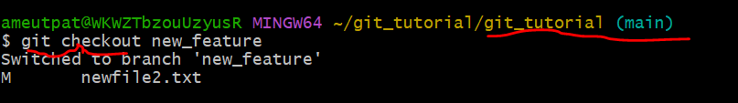
Switch Branch
Git allows you to switch between the branches without making a commit. You can switch between two branches with the git checkout command. To switch between the branches, below command is used:
git checkout <branch name>

Slide 29
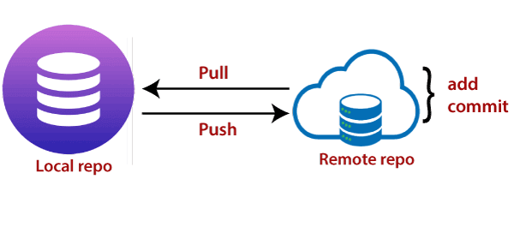
Git Push
The push term refers to upload local repository content to a remote repository. Pushing is an act of transfer commits from your local repository to a remote repository.

Slide 30
Git Push Origin Branch Name
Git push origin master is a special command-line utility that specifies the remote branch and directory. When you have multiple branches and directory, then this command assists you in determining your main branch and repository.
Generally, the term origin stands for the remote repository, and master is considered as the main branch also you can specify other branch name as well. So, the entire statement "git push origin master" pushed the local content on the master branch of the remote location.

Slide 31
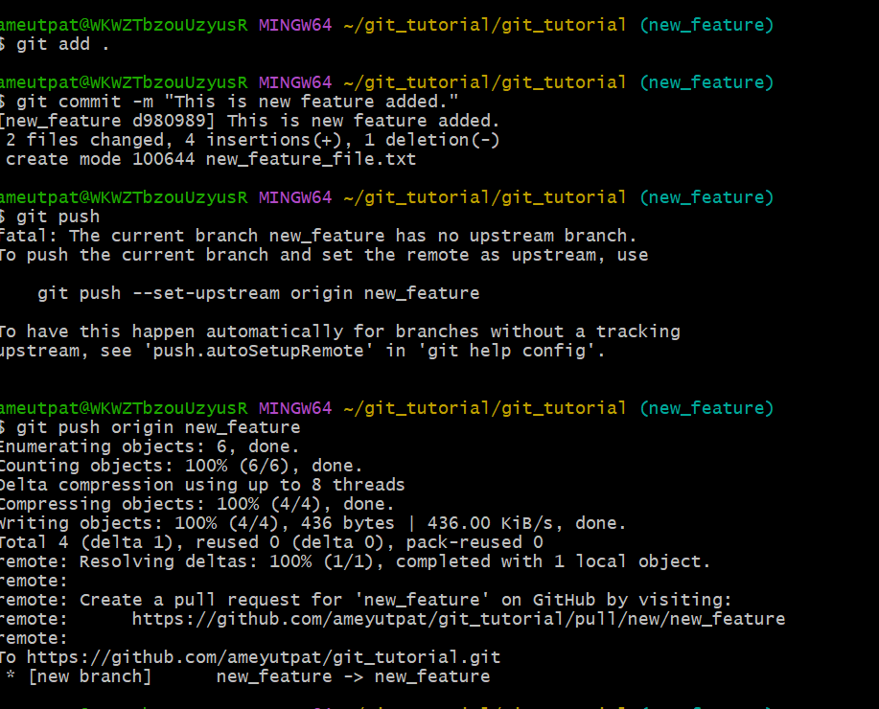
Git push

Slide 32
Git Pull Request(Don’t get confused with git pull)
Pull requests let you tell others about changes you've pushed to a branch in a repository on GitHub. Once a pull request is opened, you can discuss and review the potential changes with collaborators and add follow-up commits before your changes are merged into the base branch

Slide 33
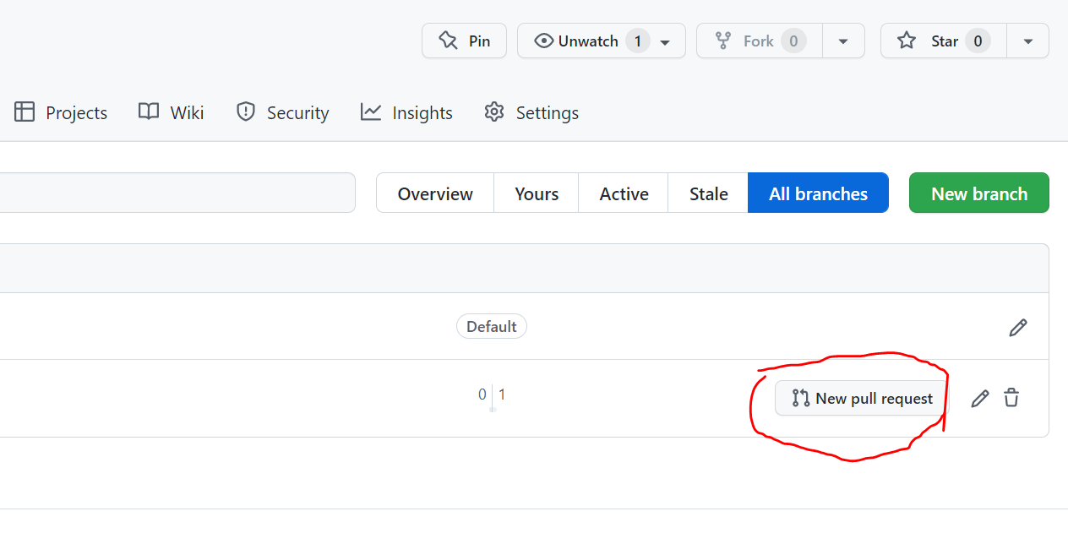

Slide 34
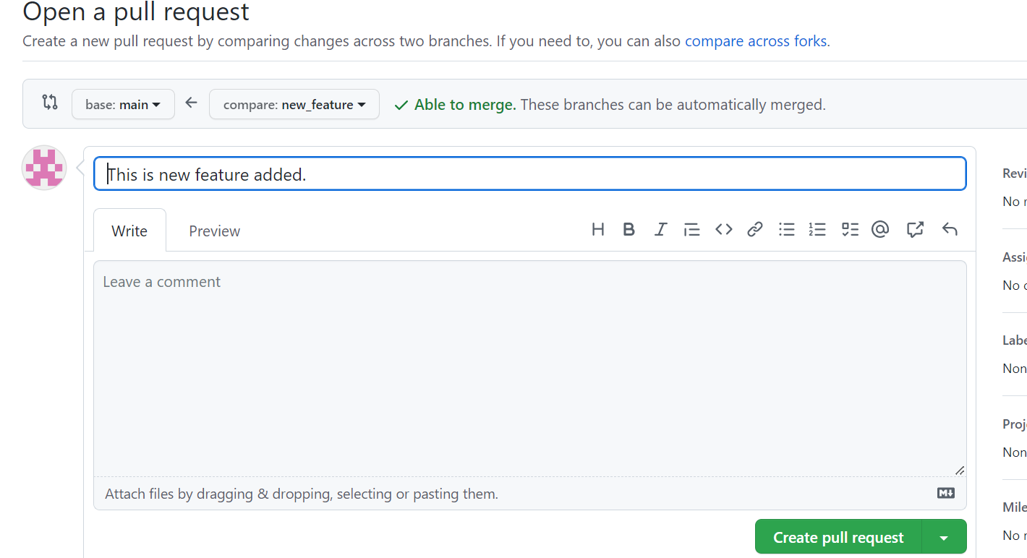

Slide 35
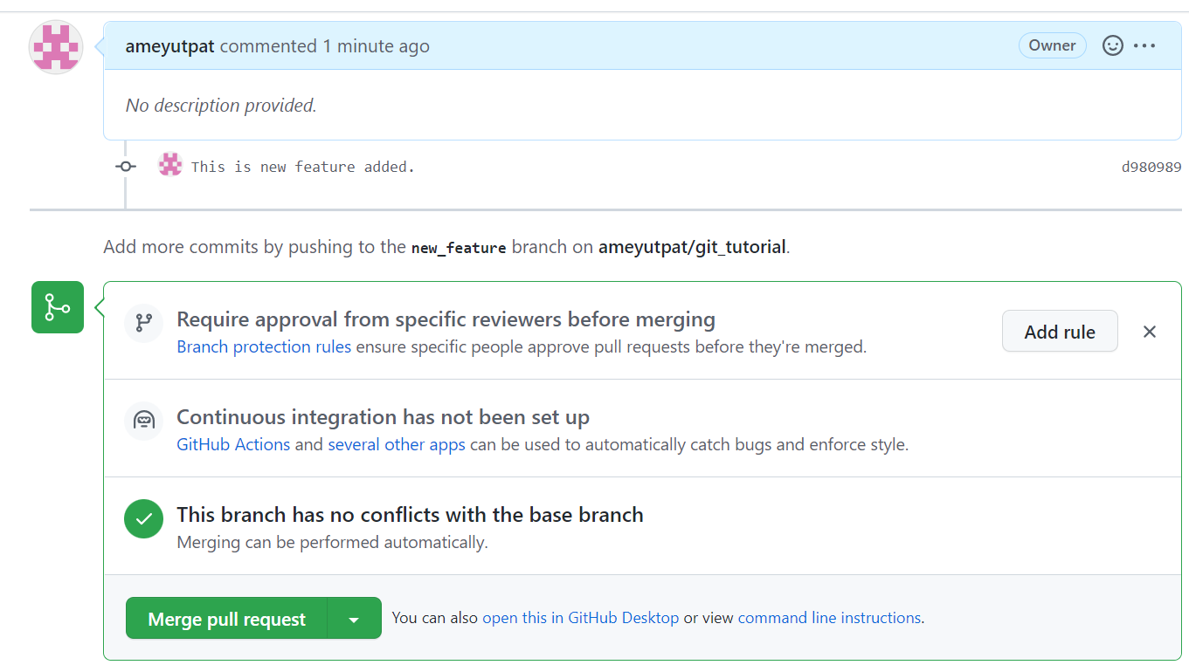

Slide 36
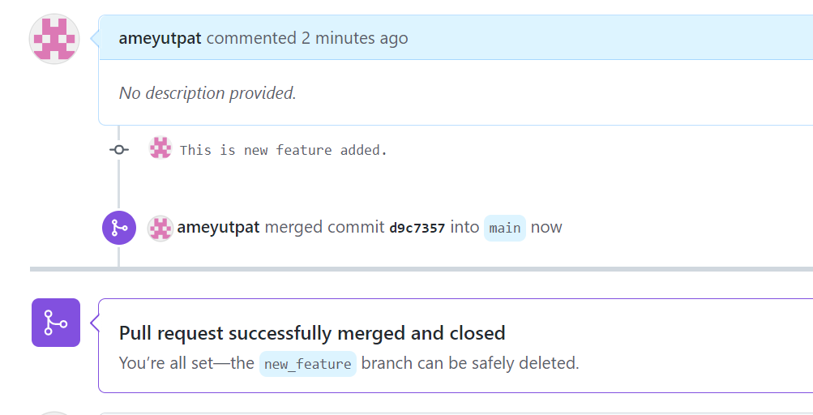

Slide 37
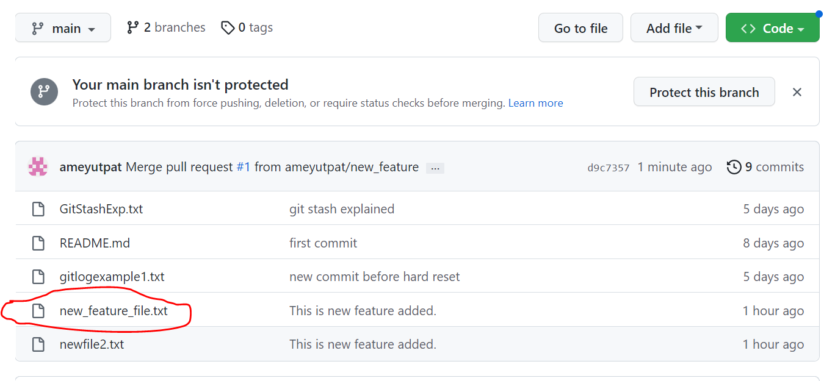
This new_feature file got merged to main branch now.

Slide 38
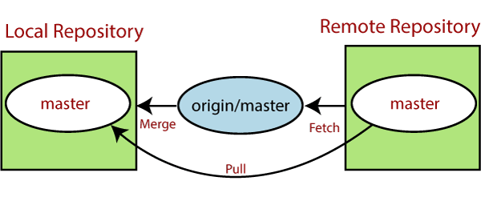
Git pull
The term pull is used to receive data from GitHub. It fetches and merges changes from the remote server to your working directory. The git pull command is used to pull a repository.

Slide 39
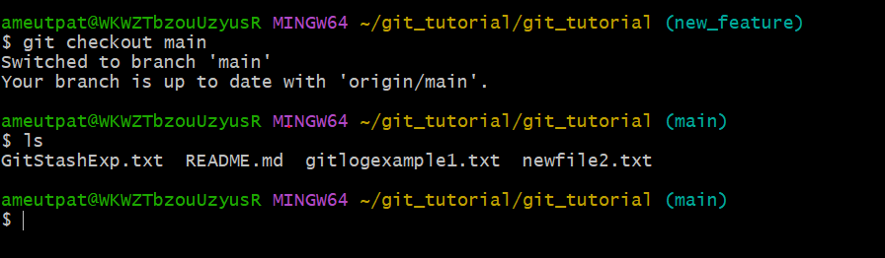
Git pull
As we merged new_feature changes to main branch but on local repository’s main branch it should get reflected.
So, to Pull that changes we need to use git pull command

Slide 40
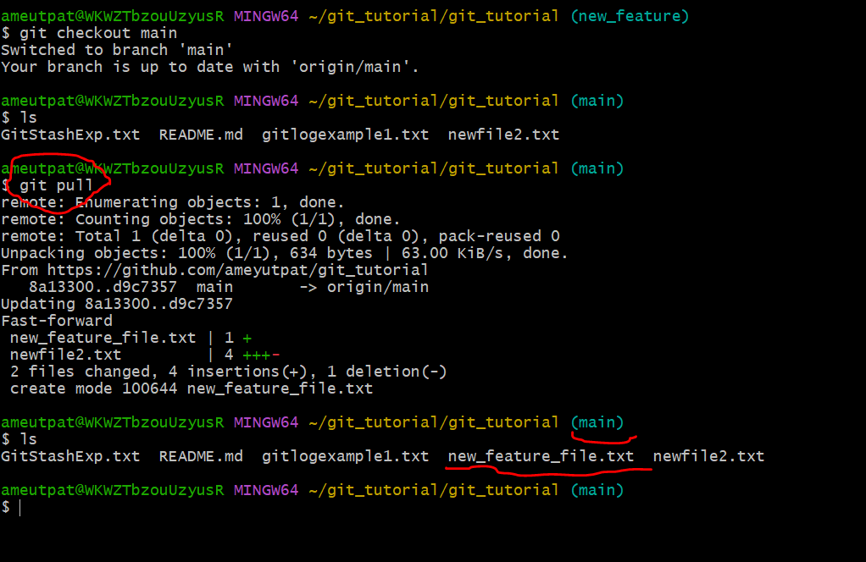

Slide 41
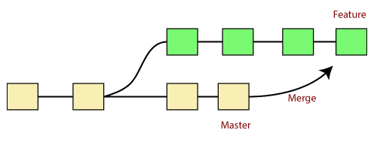
Git merge
In Git, the merging is a procedure to connect the forked history. It joins two or more development history together. The git merge command facilitates you to take the data created by git branch and integrate them into a single branch. Git merge will associate a series of commits into one unified history. Generally, git merge is used to combine two branches.

Slide 42
It is used to maintain distinct lines of development; at some stage, you want to merge the changes in one branch. It is essential to understand how merging works in Git.
In the above figure, there are two branches master and feature. We can see that we made some commits in both functionality and master branch, and merge them. It works as a pointer. It will find a common base commit between branches. Once Git finds a shared base commit, it will create a new "merge commit." It combines the changes of each queued merge commit sequence.

Slide 43
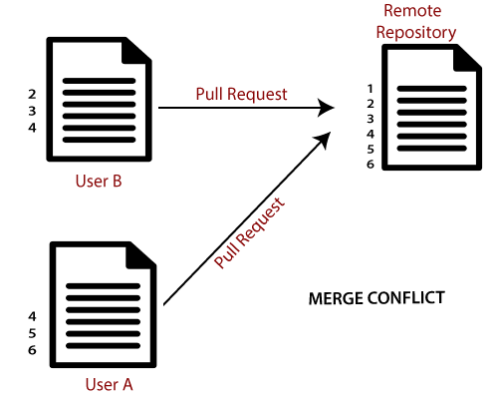
Git Merge Conflict issue:
When two branches are trying to merge, and both are edited at the same time and in the same file, Git won't be able to identify which version is to take for changes. Such a situation is called merge conflict. If such a situation occurs, it stops just before the merge commit so that you can resolve the conflicts manually.

Slide 44
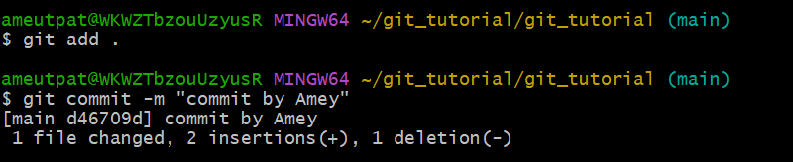
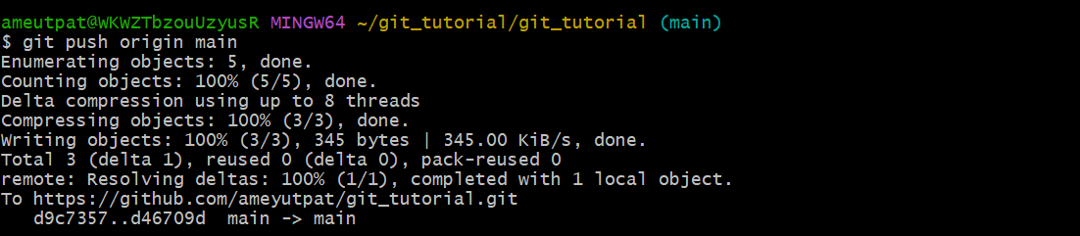
Amey made changes in new_feature_file.txt and pushed my changes to main branch.

Slide 45
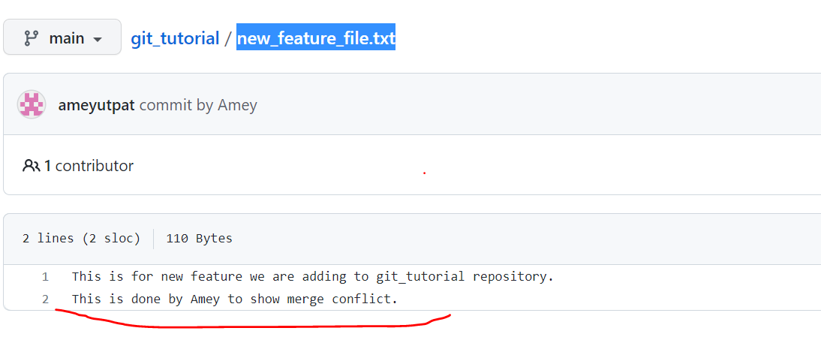
Initial file changes added by Amey.

Slide 46
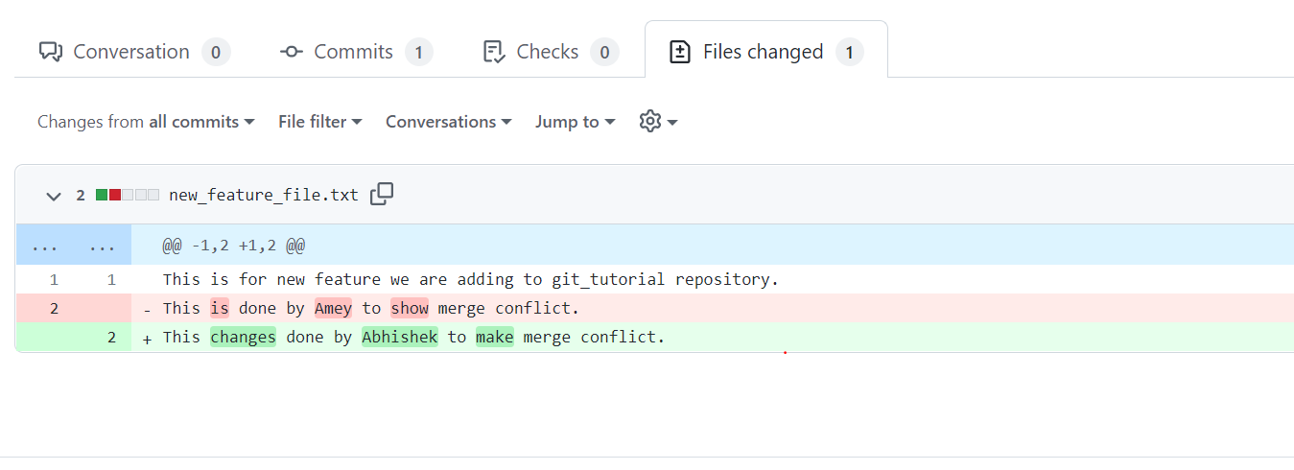
Changes added by Abhishek in same line

Slide 47
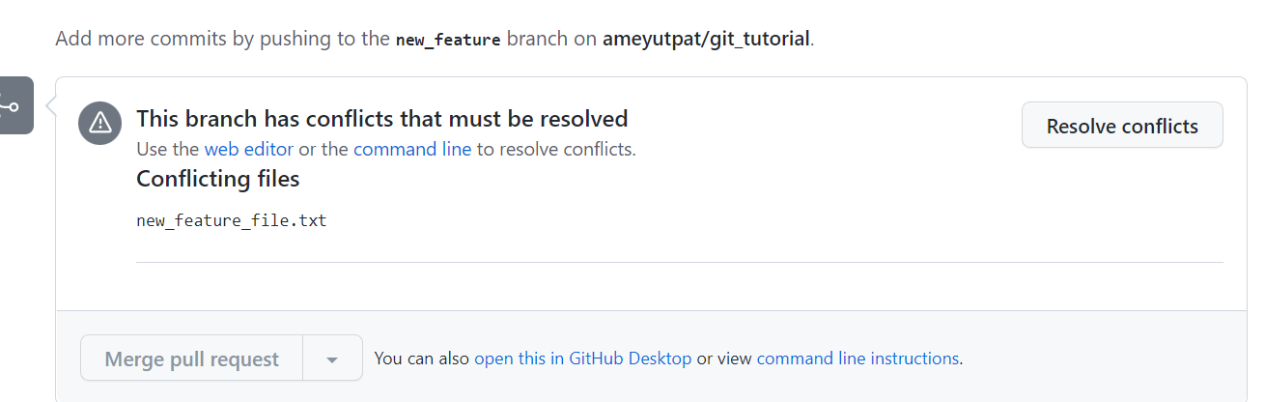

Slide 48
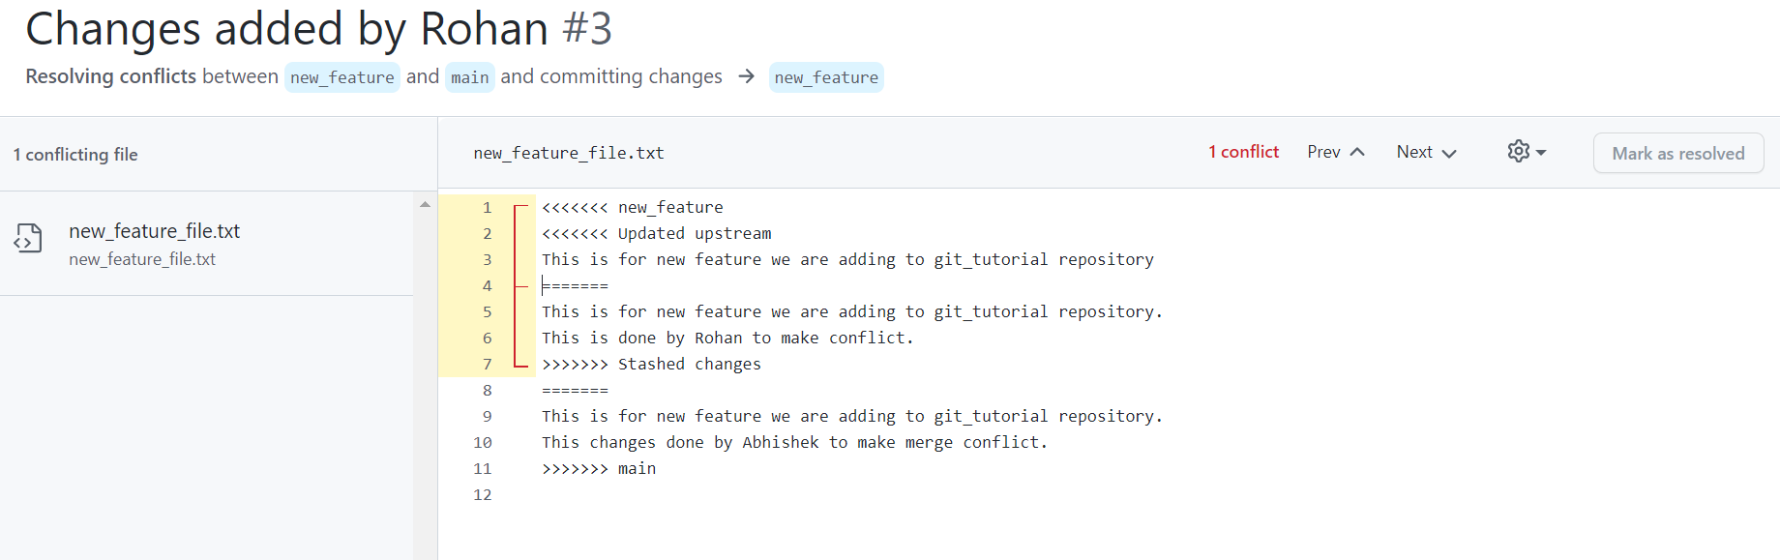

Slide 49
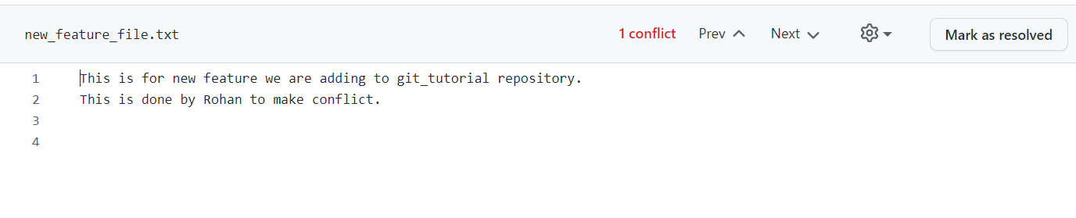
I have taken Rohan’s changes

